Slide 1
Introductions, Defining Data Science and Ethics, Intro to R and R Studio
SSEP 2022 Morning Day 1
Dr. Ab Mosca (they/them)
Slides based on slides courtesy of Jordan Crouser: https://jcrouser.github.io/MassMutual-IntroR/, https://jcrouser.github.io/MassMutual-DataVis/, https://beanumber.github.io/sds192/

Slide 2
Introductions

Slide 3
Course Staff
Dr. Ab Mosca (they/them)
Esa Schenck (they/them)
BA in Mathematics, Smith College 2014
PhD in Computer Science, Tufts University 2021
Assistant Teaching Professor, Northeastern University
Research Area: Data Visualization
Website: https://www.khoury.northeastern.edu/home/amosca/
Smith College Class of 2023
Major: Data Science

Slide 4
Classmates
Ice Breaker #1
Break into groups of 3
Introduce yourself
What is one piece of media that you consumed over the summer that you enjoyed?
Movie, tv show, book, etc.
Find one common attribute between all of you.
Do you all like the same food? Do you all enjoy the same music? Do you all live in the same place?
Add your answer to this Jamboard to share with the class: Ice Breaker Jamboard

Slide 5
Classmates
Ice Breaker #2
Break into new groups of 3
Introduce yourself
What is one thing you hope to learn in this class?
Add your answers to this Jamboard to share with the class: Ice Breaker Jamboard

Slide 6
Classmates
Ice Breaker #3
Break into new groups of 3
Introduce yourself
What is one thing you are nervous about for this class?
Add your answers to this Jamboard to share with the class: Ice Breaker Jamboard

Slide 7
Ice Breaker Recap
Let’s look at the outcome of our ice breaker questions
Ice Breaker Jamboard

Slide 8
Defining Data Science and Ethics

Slide 9
Defining Data Science
How would you define data science?
Talk it out with the person sitting next to you then add your definition to this Jamboard: Definitions Jamboard

Slide 10
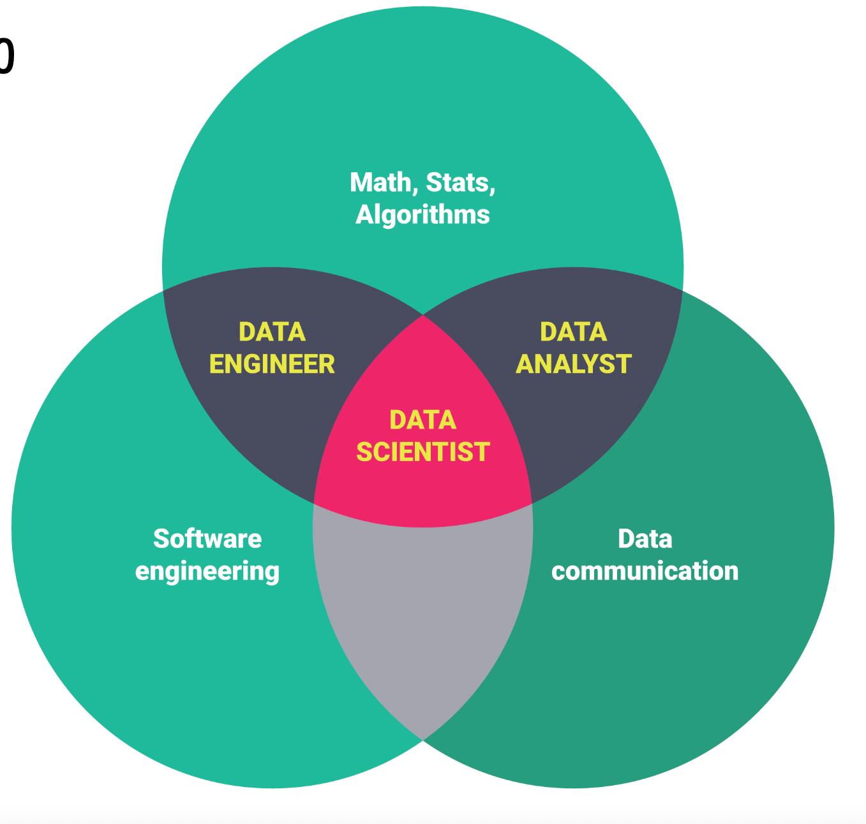
Definition: Data Science

Slide 11
Defining Ethics
How would you define ethics?
Talk it out with the person sitting next to you then add your definition to this Jamboard: Definitions Jamboard

Slide 12
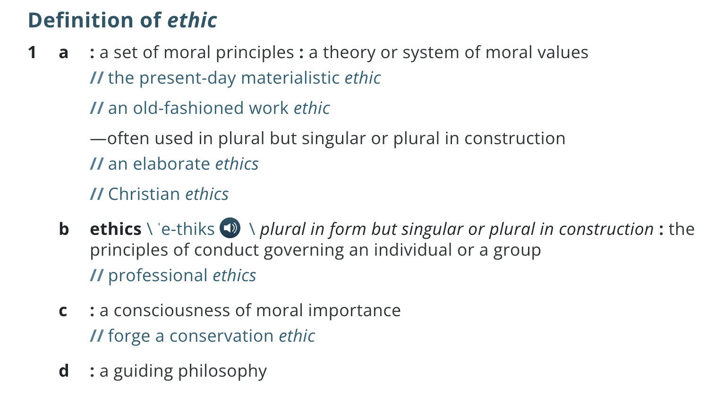
Definition: Ethics
https://www.merriam-webster.com/dictionary/ethic

Slide 13
Defining Ethical Data Science
How would you define ethical data science?
Talk it out with the person sitting next to you then add your definition to this Jamboard: Definitions Jamboard

Slide 14
Definition: Ethical Data Science
Applying theories and systems of moral values (ethics) to our data science work

Slide 15
Ethical Data Science
Applying theories and systems of moral values (ethics) to our data science work
Why is this important?

Slide 16

Ethical Data Science
Applying theories and systems of moral values (ethics) to our data science work
Why is this important?

Slide 17
Ethical Data Science
Applying theories and systems of moral values (ethics) to our data science work
Why is this important?
Can you think of other examples of things that can go wrong with data science?

Slide 18
Ethical Data Science
Applying theories and systems of moral values (ethics) to our data science work
Why is this important?
To combat algorithmic bias
To protect personal, identifying information
To increase reproducibility and replicability
Systems of power are woven into our society, and so are misunderstandings of what data science is and how it works

Slide 19
Take a break – stand up, chat with neighbors, use the restroom. We’ll start again in 10 minutes ☺

Slide 20
Intro to R and R Studio

Slide 21


What are R and R Studio?
R
R Studio
Statistical Programming Language
An Interactive Development Environment (IDE) for R

Slide 22
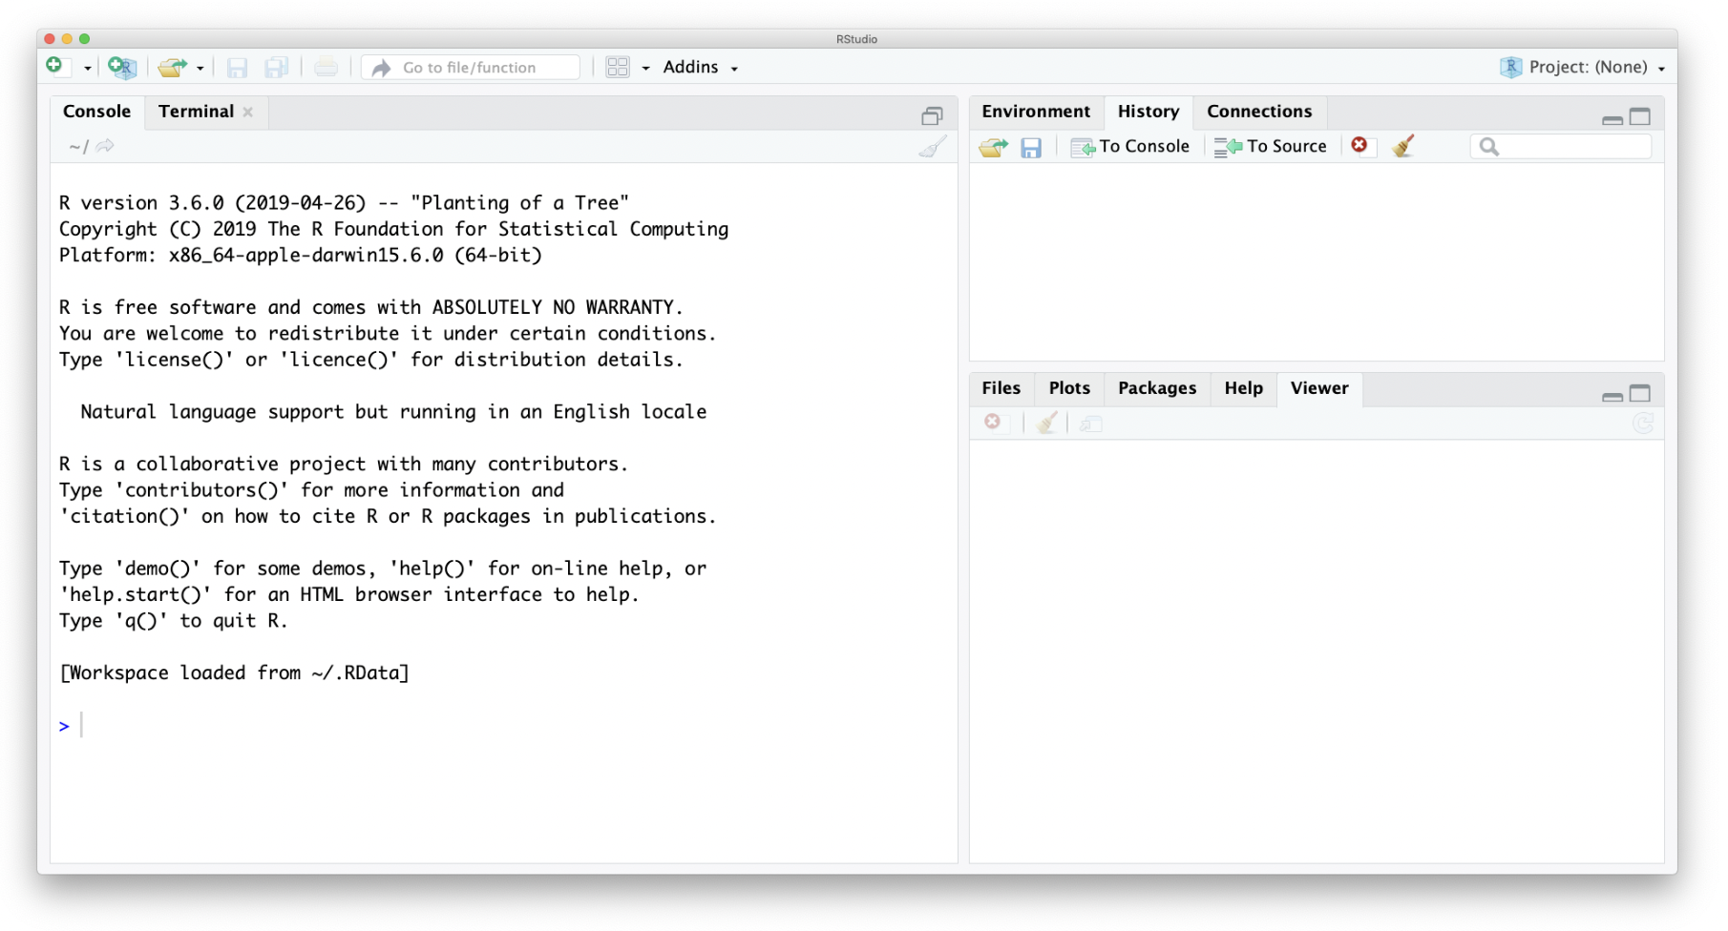
R Studio

Slide 23
R Studio
Console
Prompt
Notes:
Console == where commands get typed

Slide 24
R Studio
Command History
Notes:
Console == where commands get typed

Slide 25
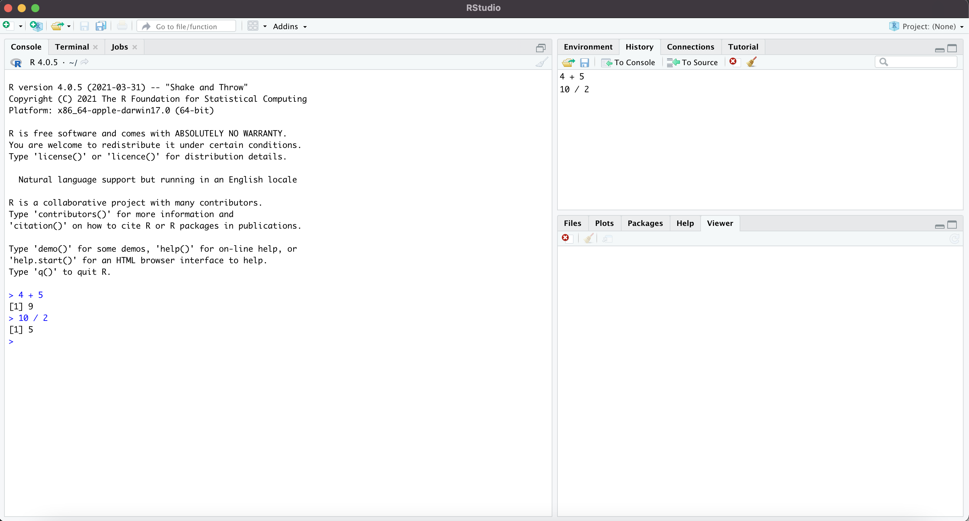
R Studio
History
Prompt
Notes:
Console == where commands get typed

Slide 26
R Studio
Clear History
Prompt
Notes:
Console == where commands get typed

Slide 27
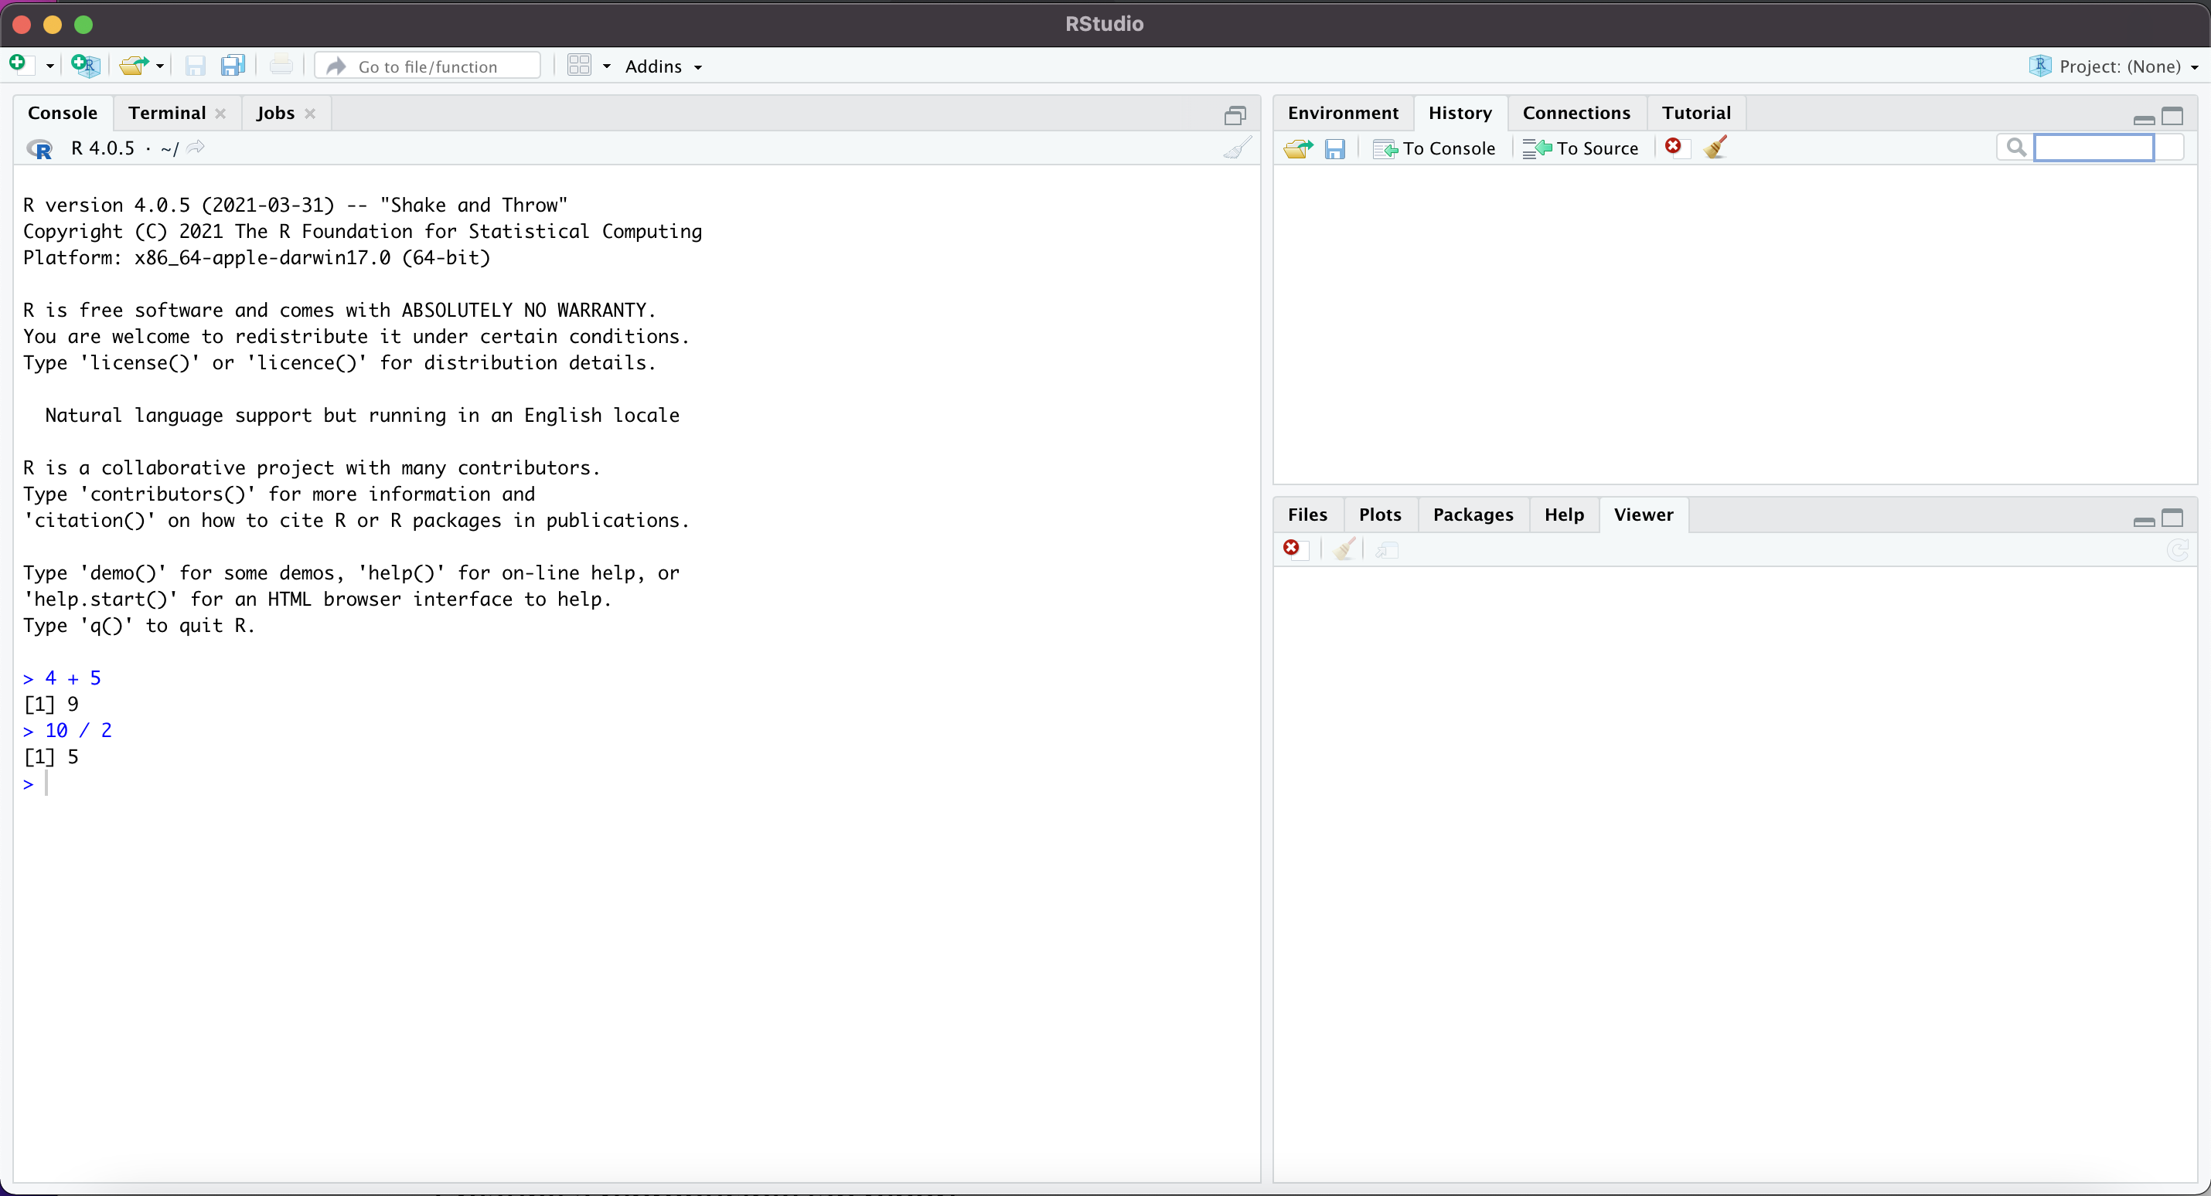
R Studio
Clear History
Prompt
Notes:
Console == where commands get typed

Slide 28
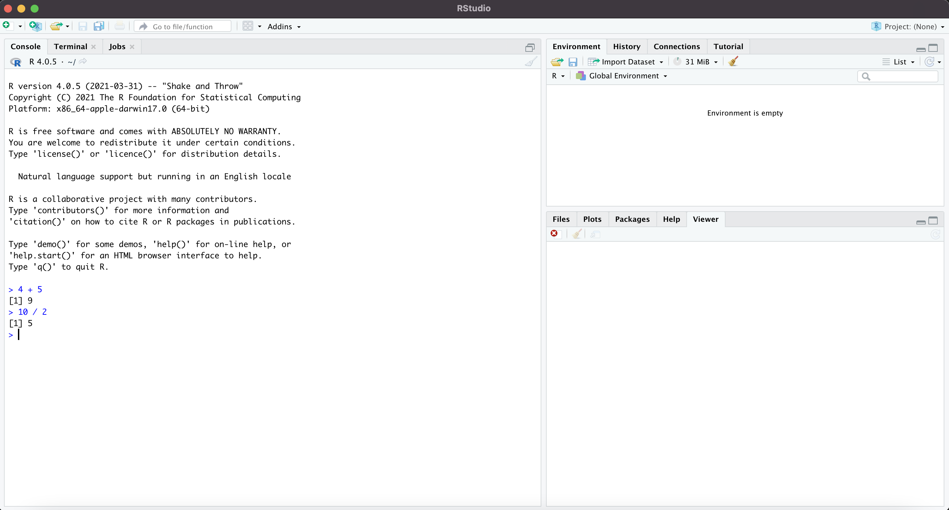
R Studio
Environment
Notes:
Console == where commands get typed

Slide 29
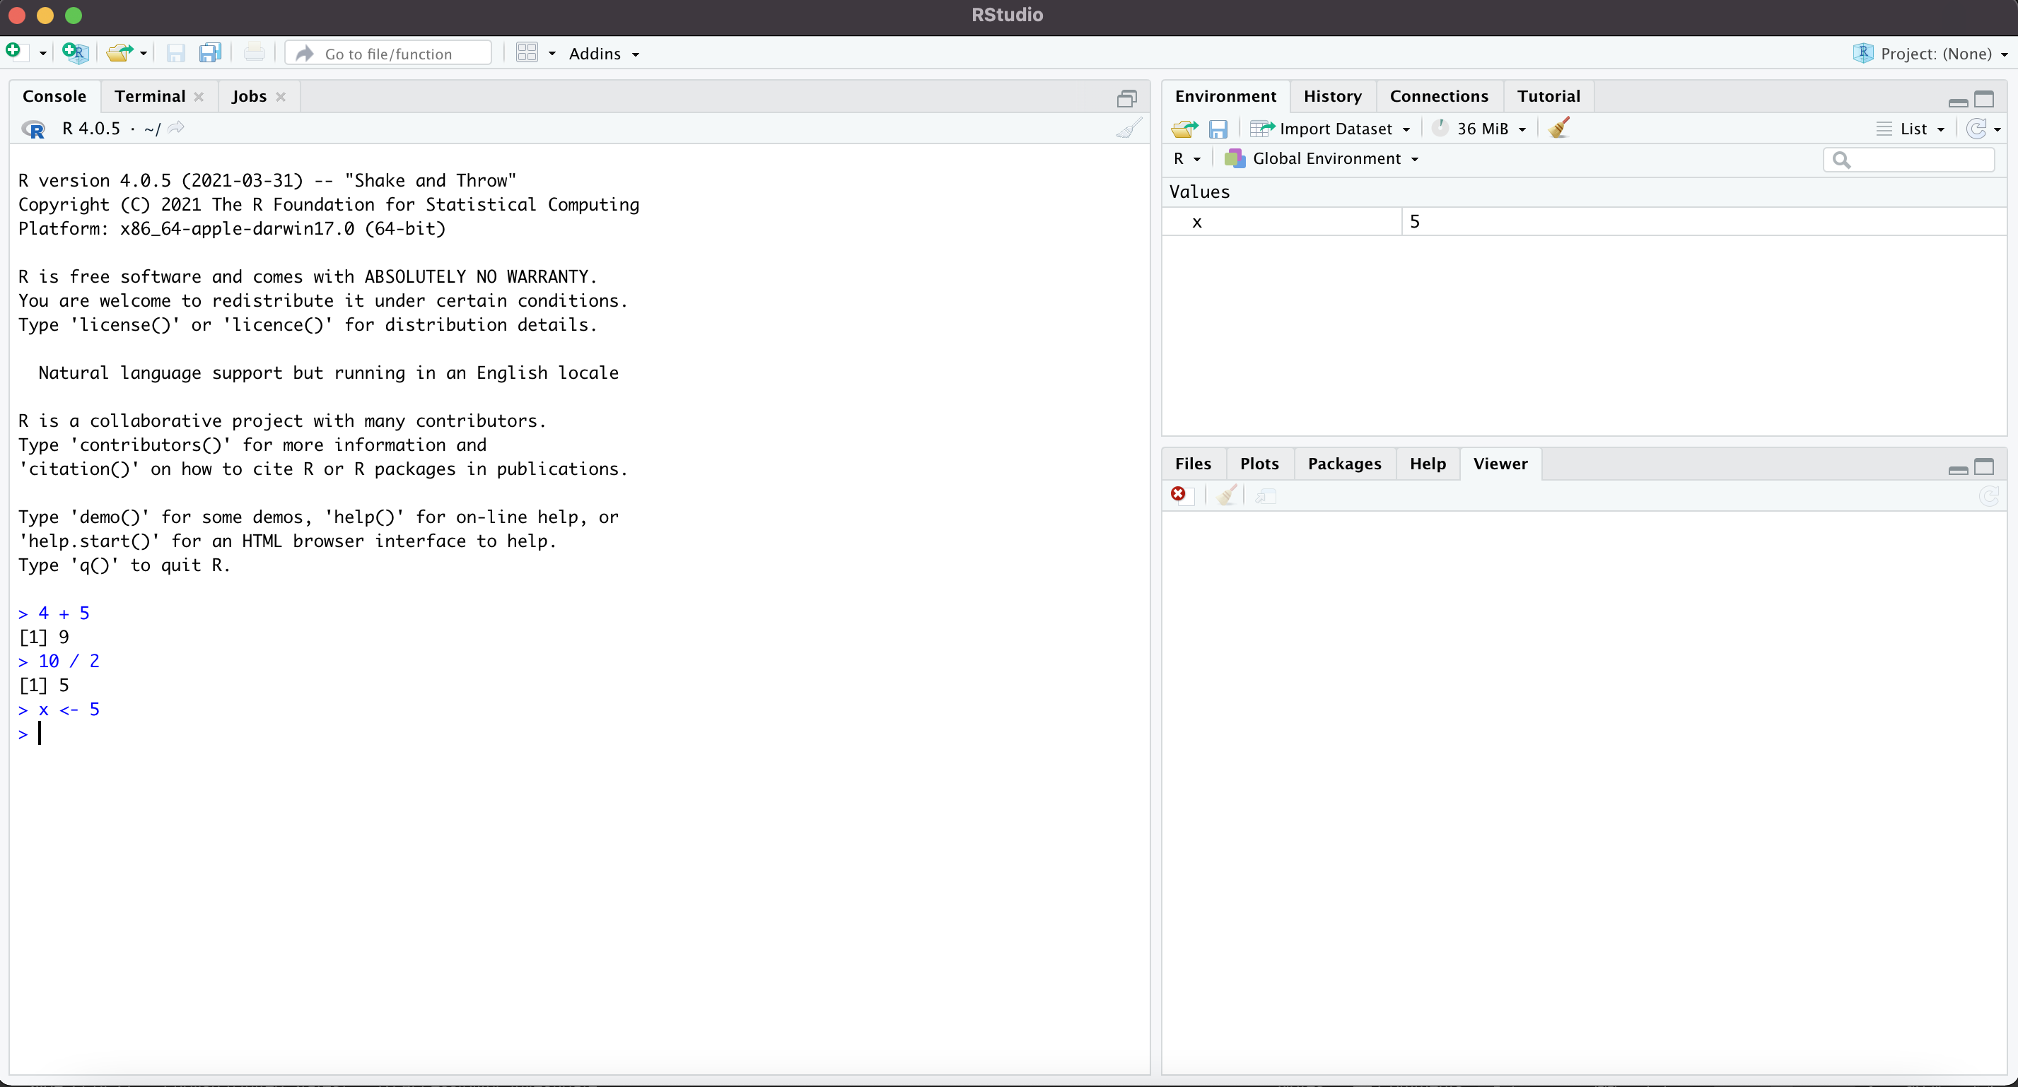
R Studio
Environment
Prompt
Notes:
Console == where commands get typed

Slide 30
R Studio
Clear
Prompt
Notes:
Console == where commands get typed

Slide 31
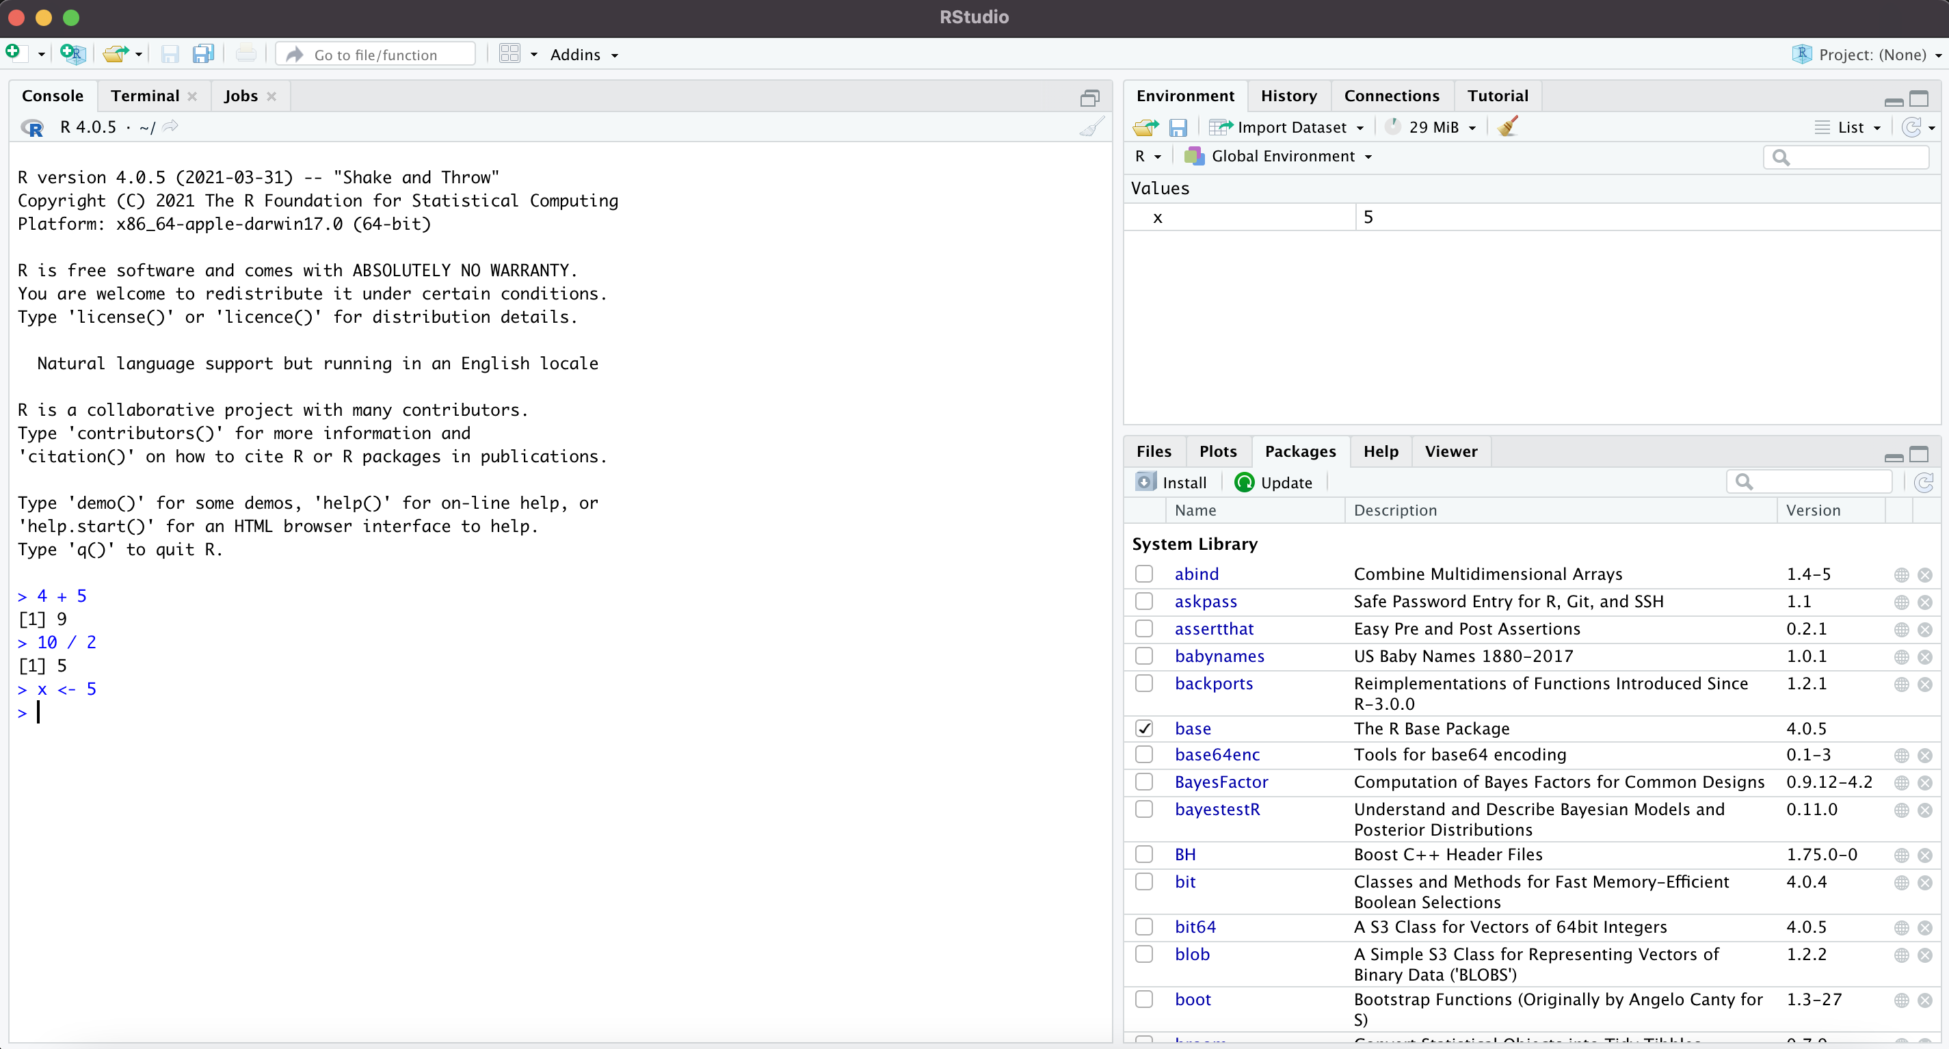
R Studio
Environment
Notes:
Console == where commands get typed

Slide 32
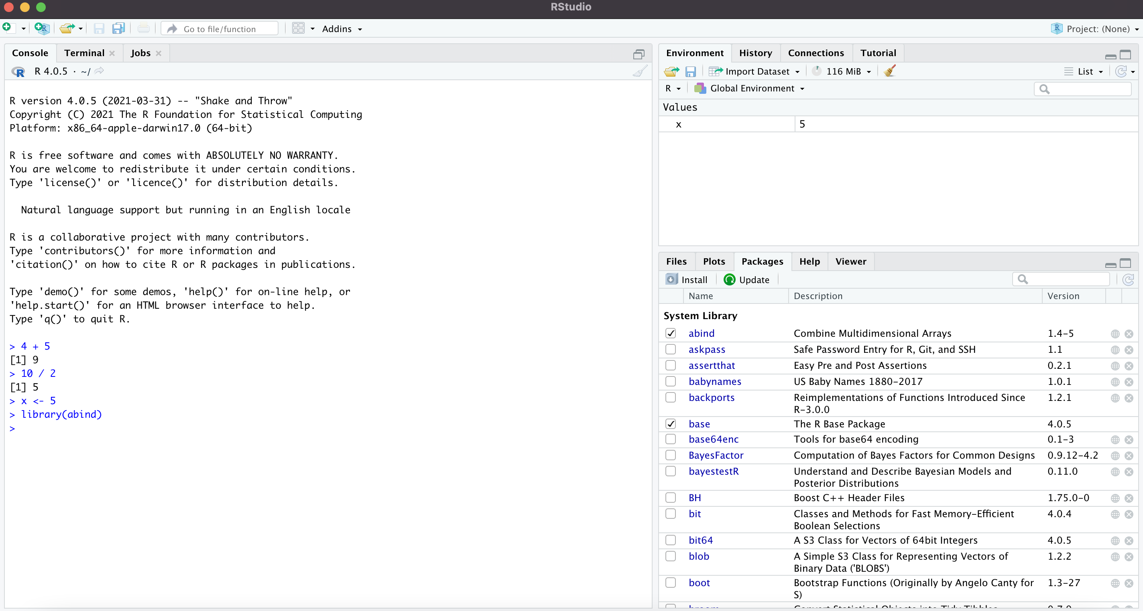
R Studio
Environment
Prompt
Notes:
Console == where commands get typed

Slide 33
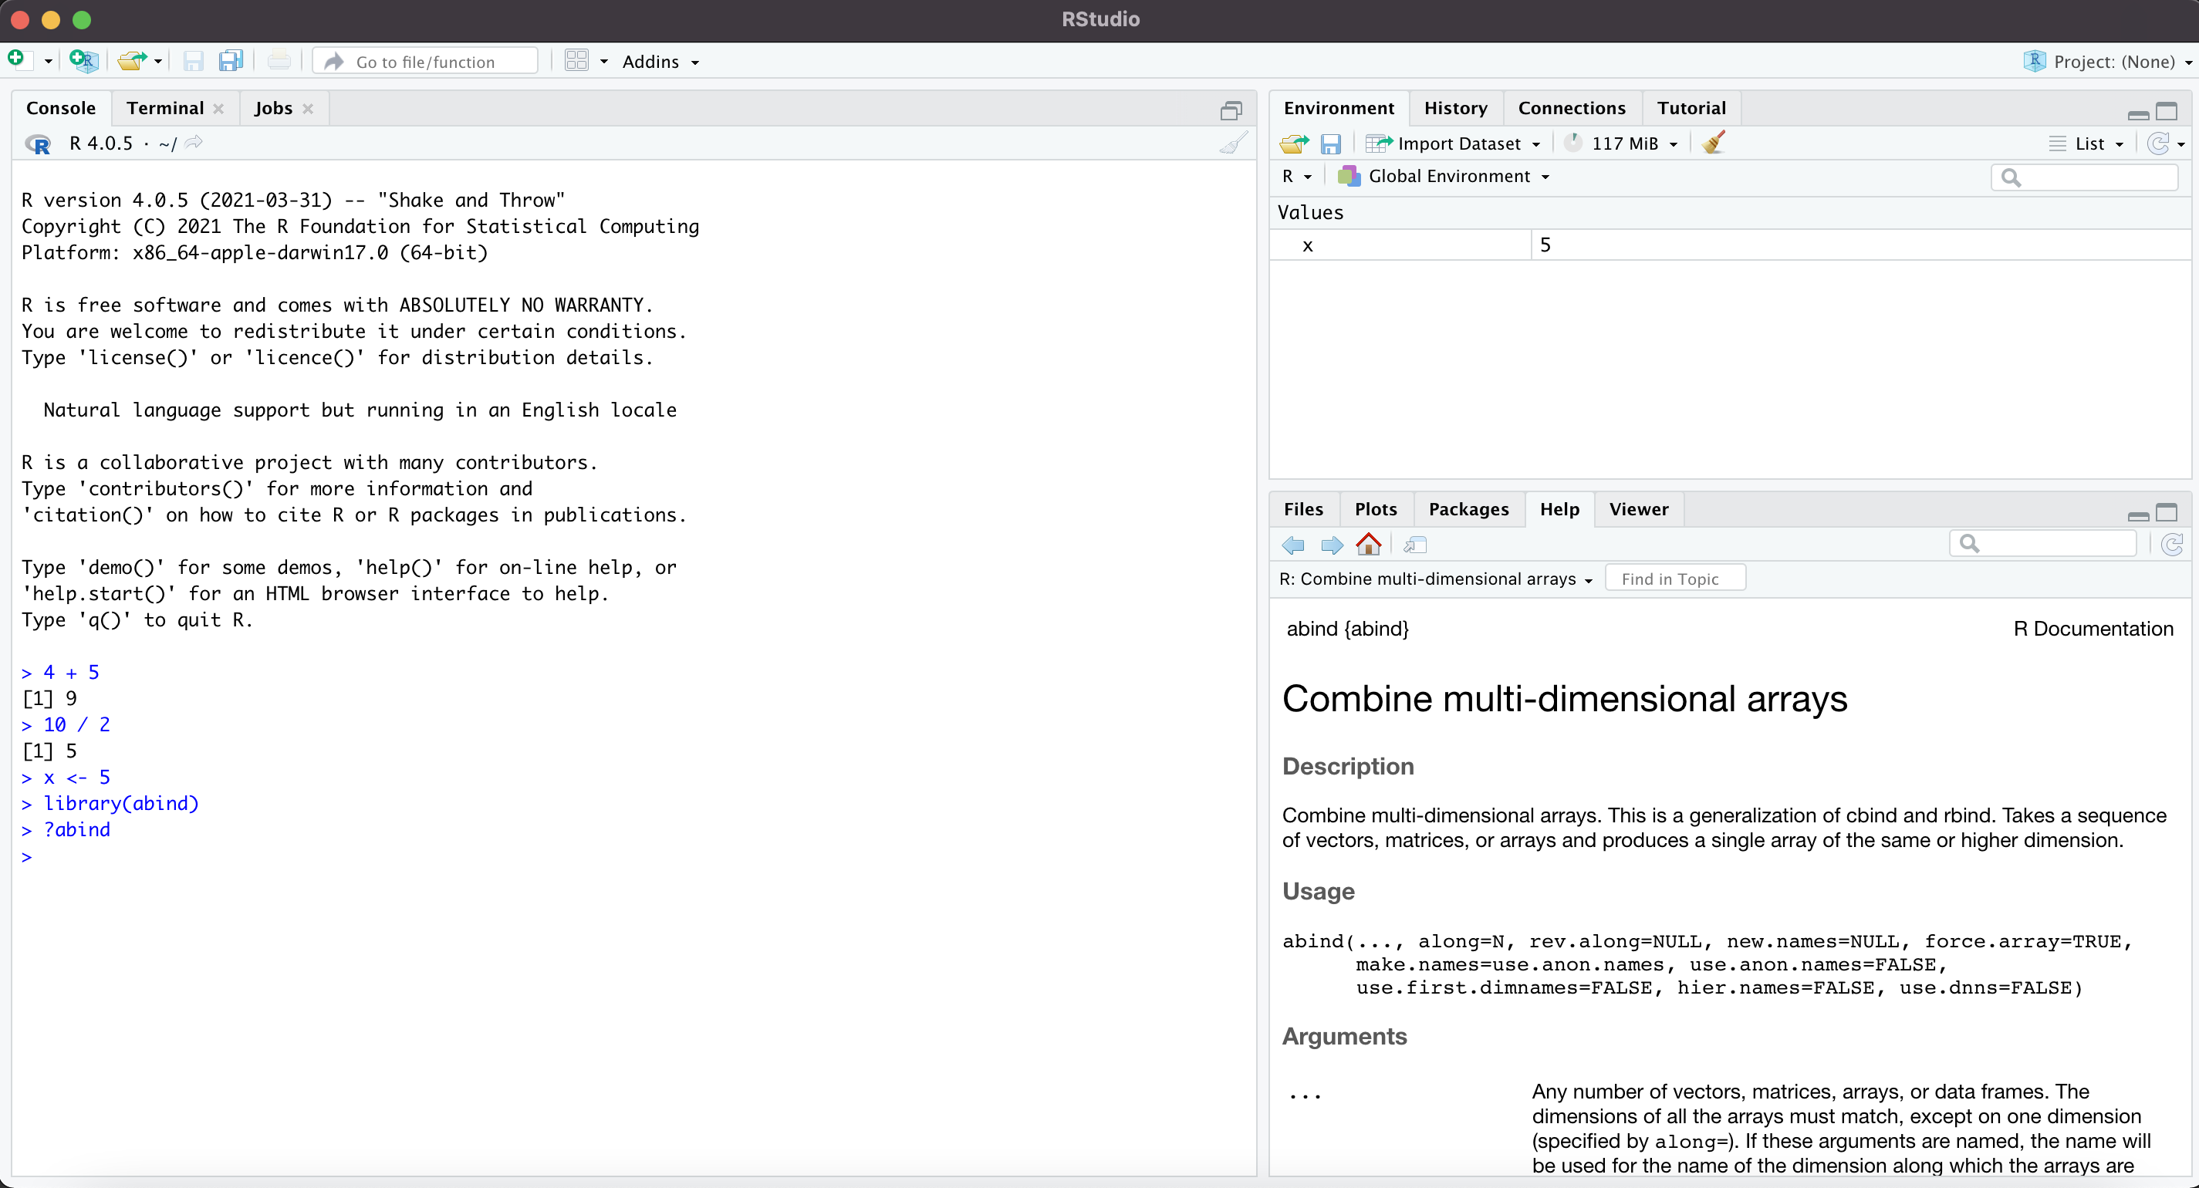
R Studio
Help
Prompt
Notes:
Console == where commands get typed

Slide 34
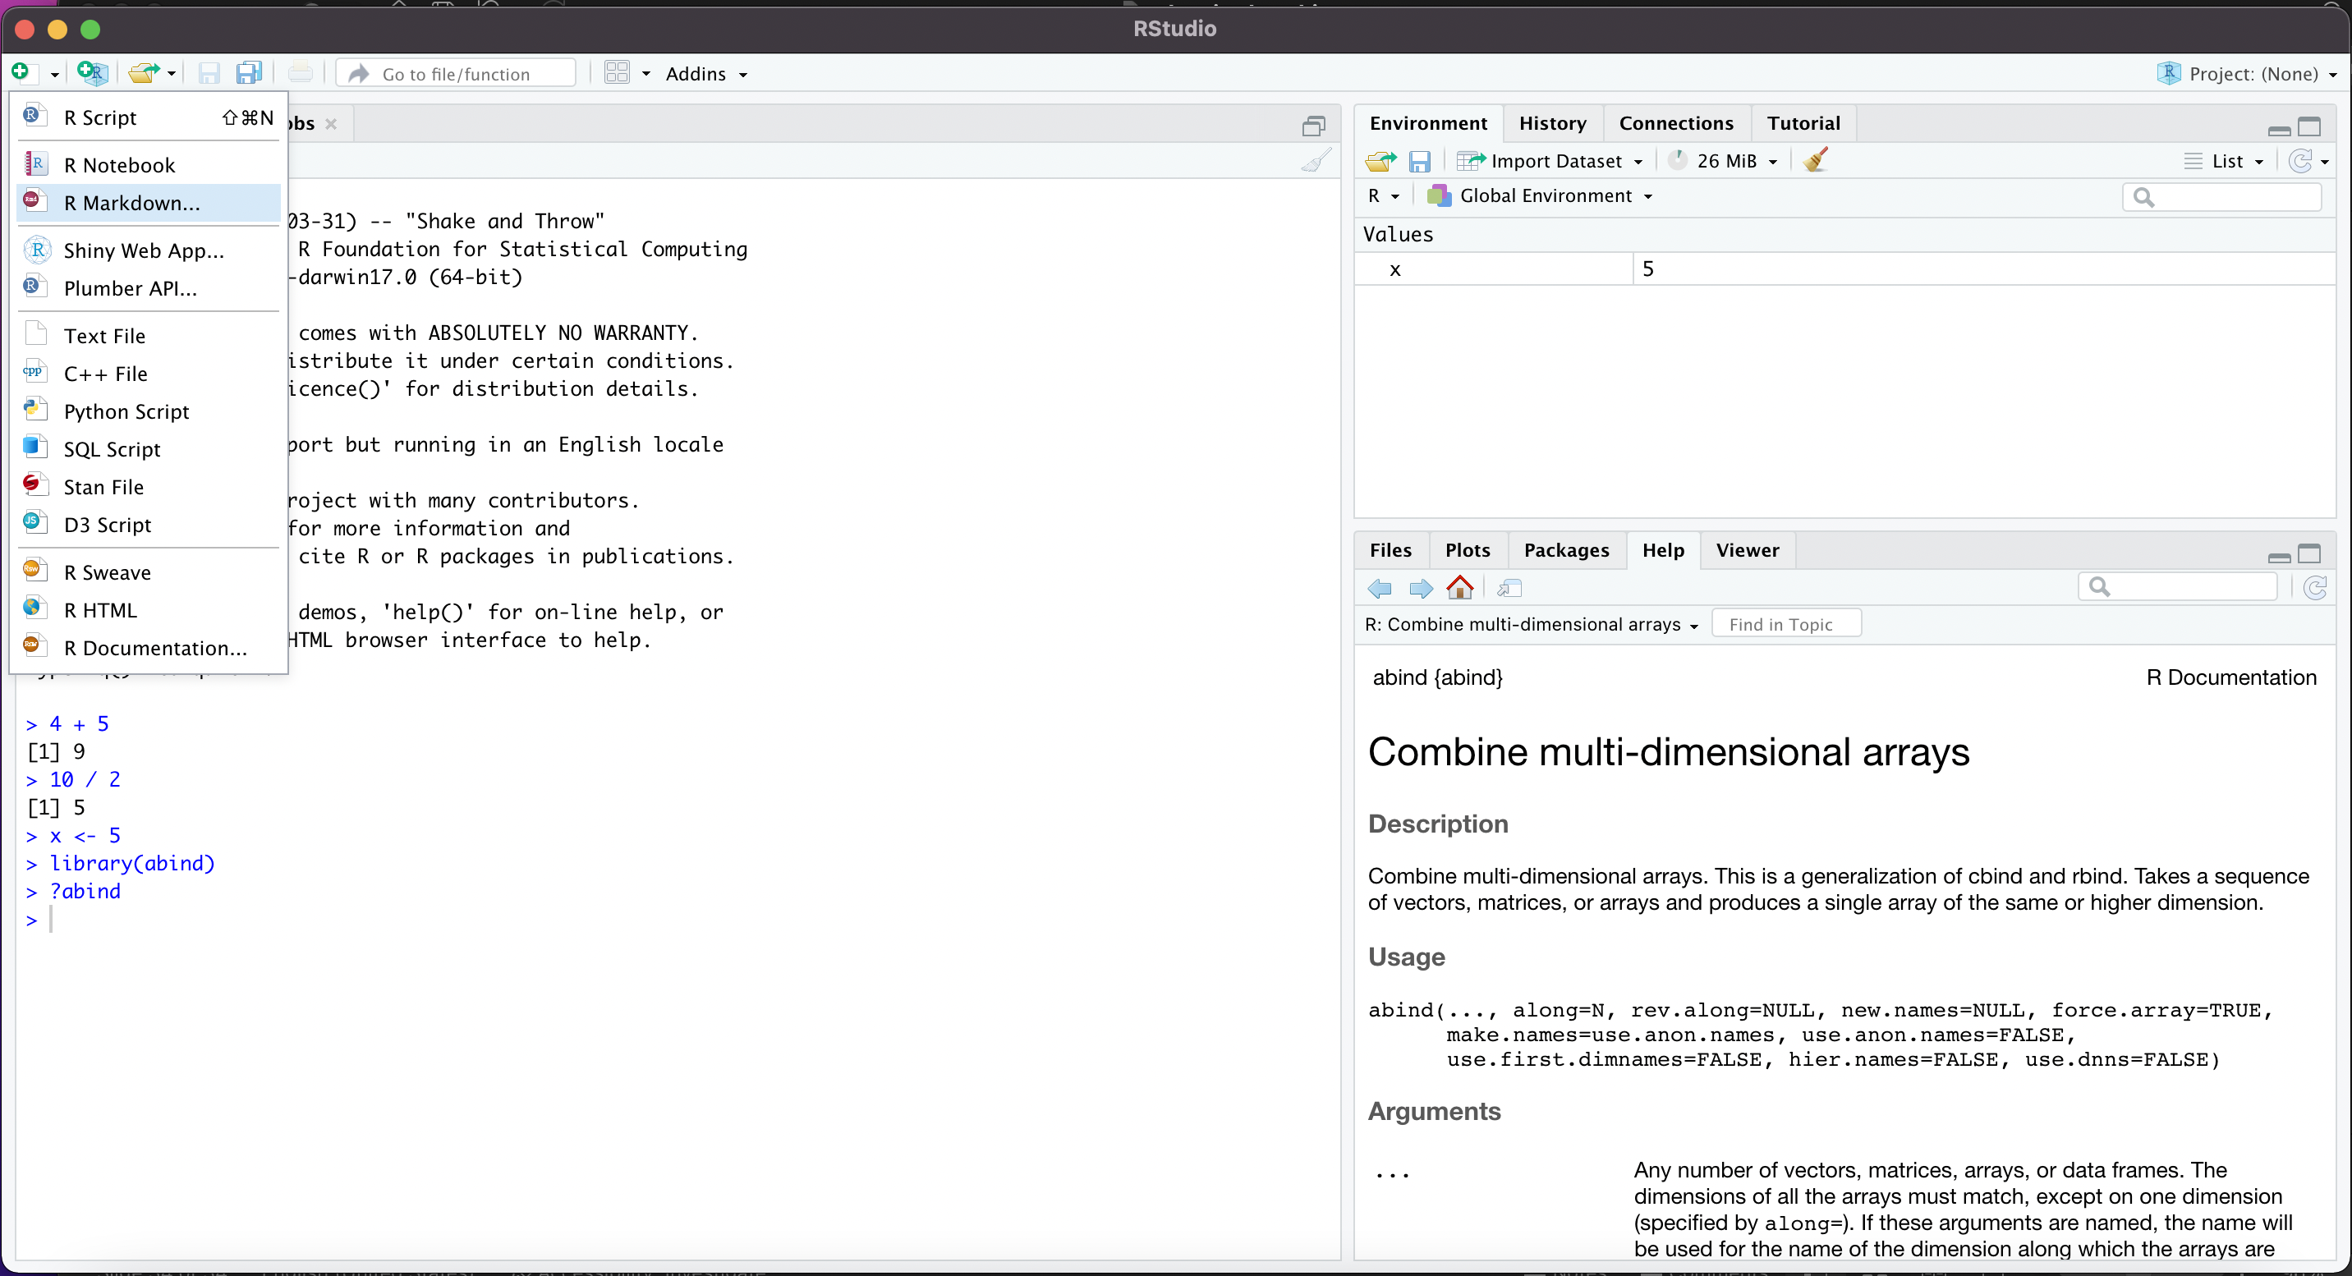
R Markdown
Notes:
Console == where commands get typed

Slide 35
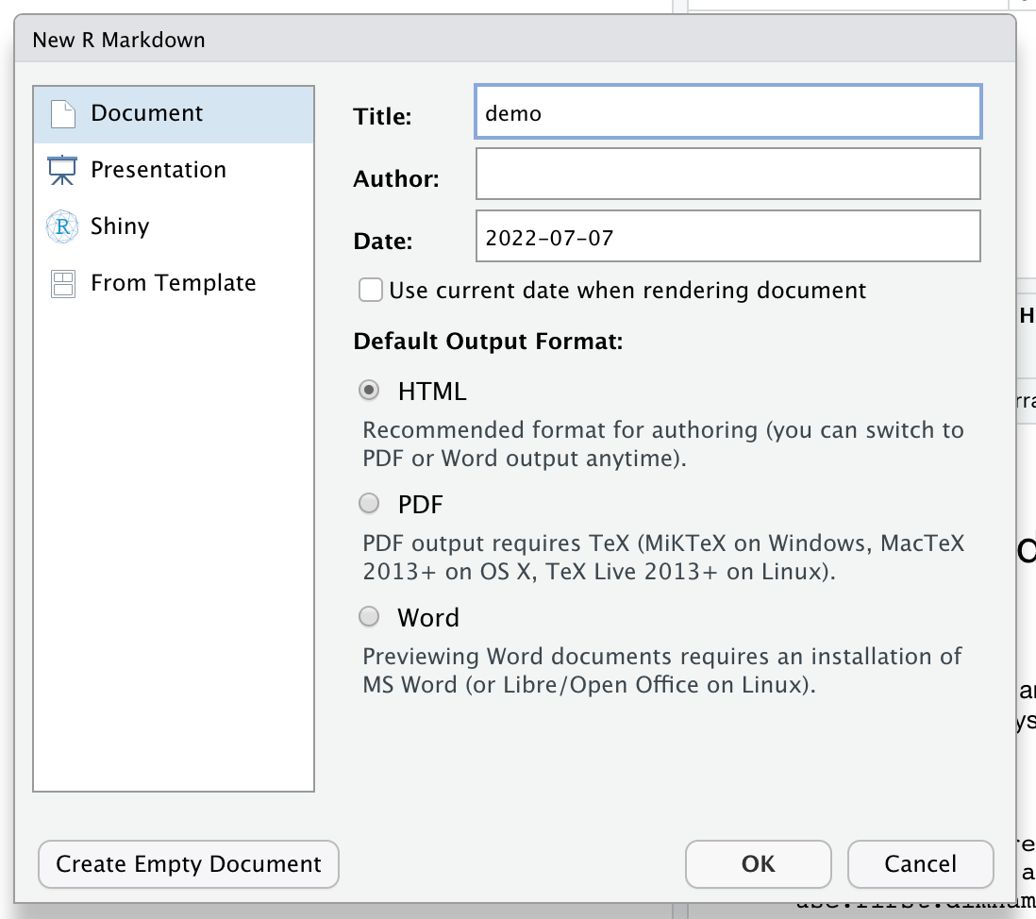
R Markdown
Notes:
Console == where commands get typed

Slide 36
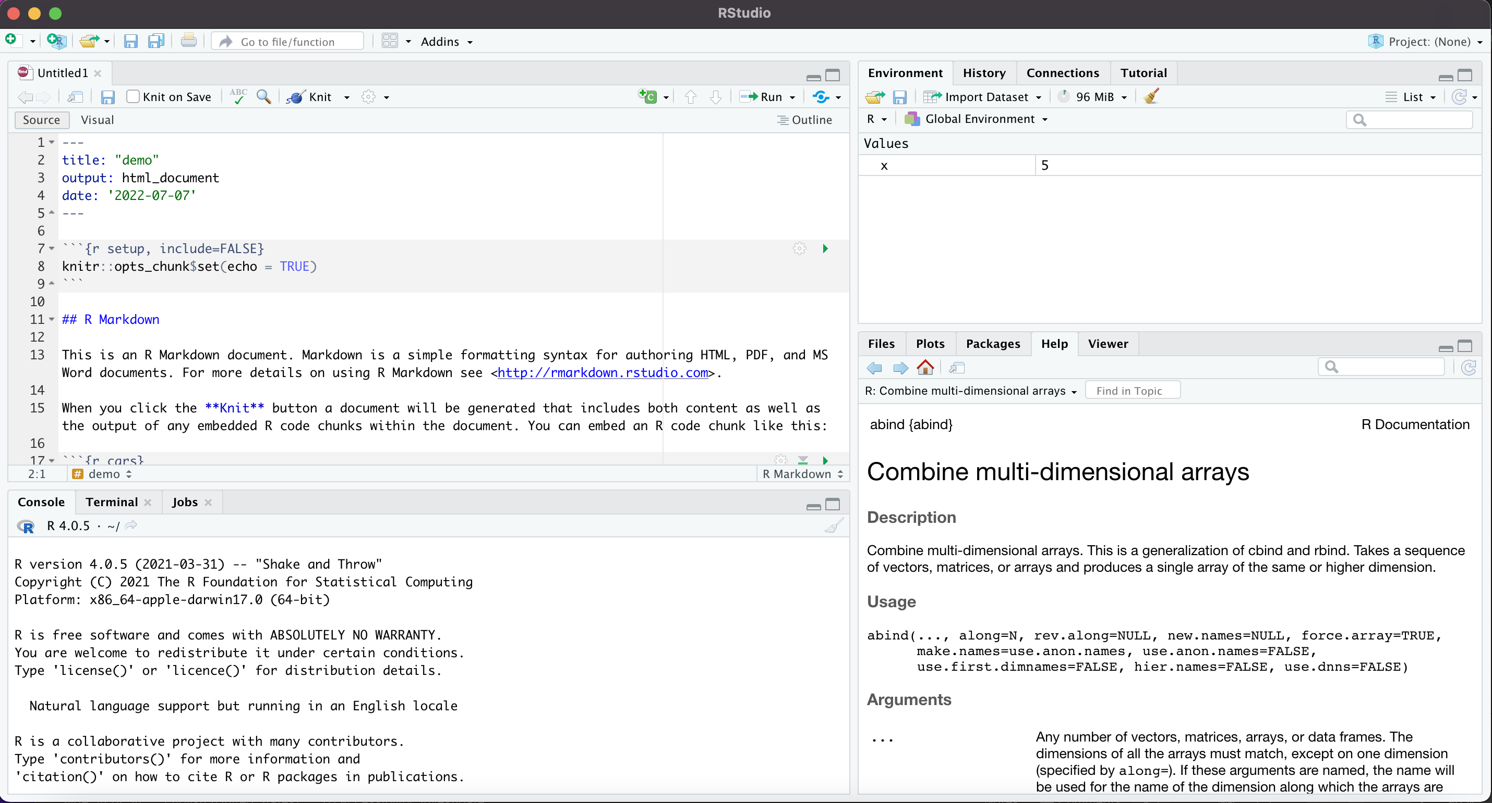
R Markdown
Markdown File
Notes:
Console == where commands get typed

Slide 37
R Markdown
Notes:
Console == where commands get typed

Slide 38
R Markdown
Code Chunk
Text Chunk
Notes:
Console == where commands get typed

Slide 39
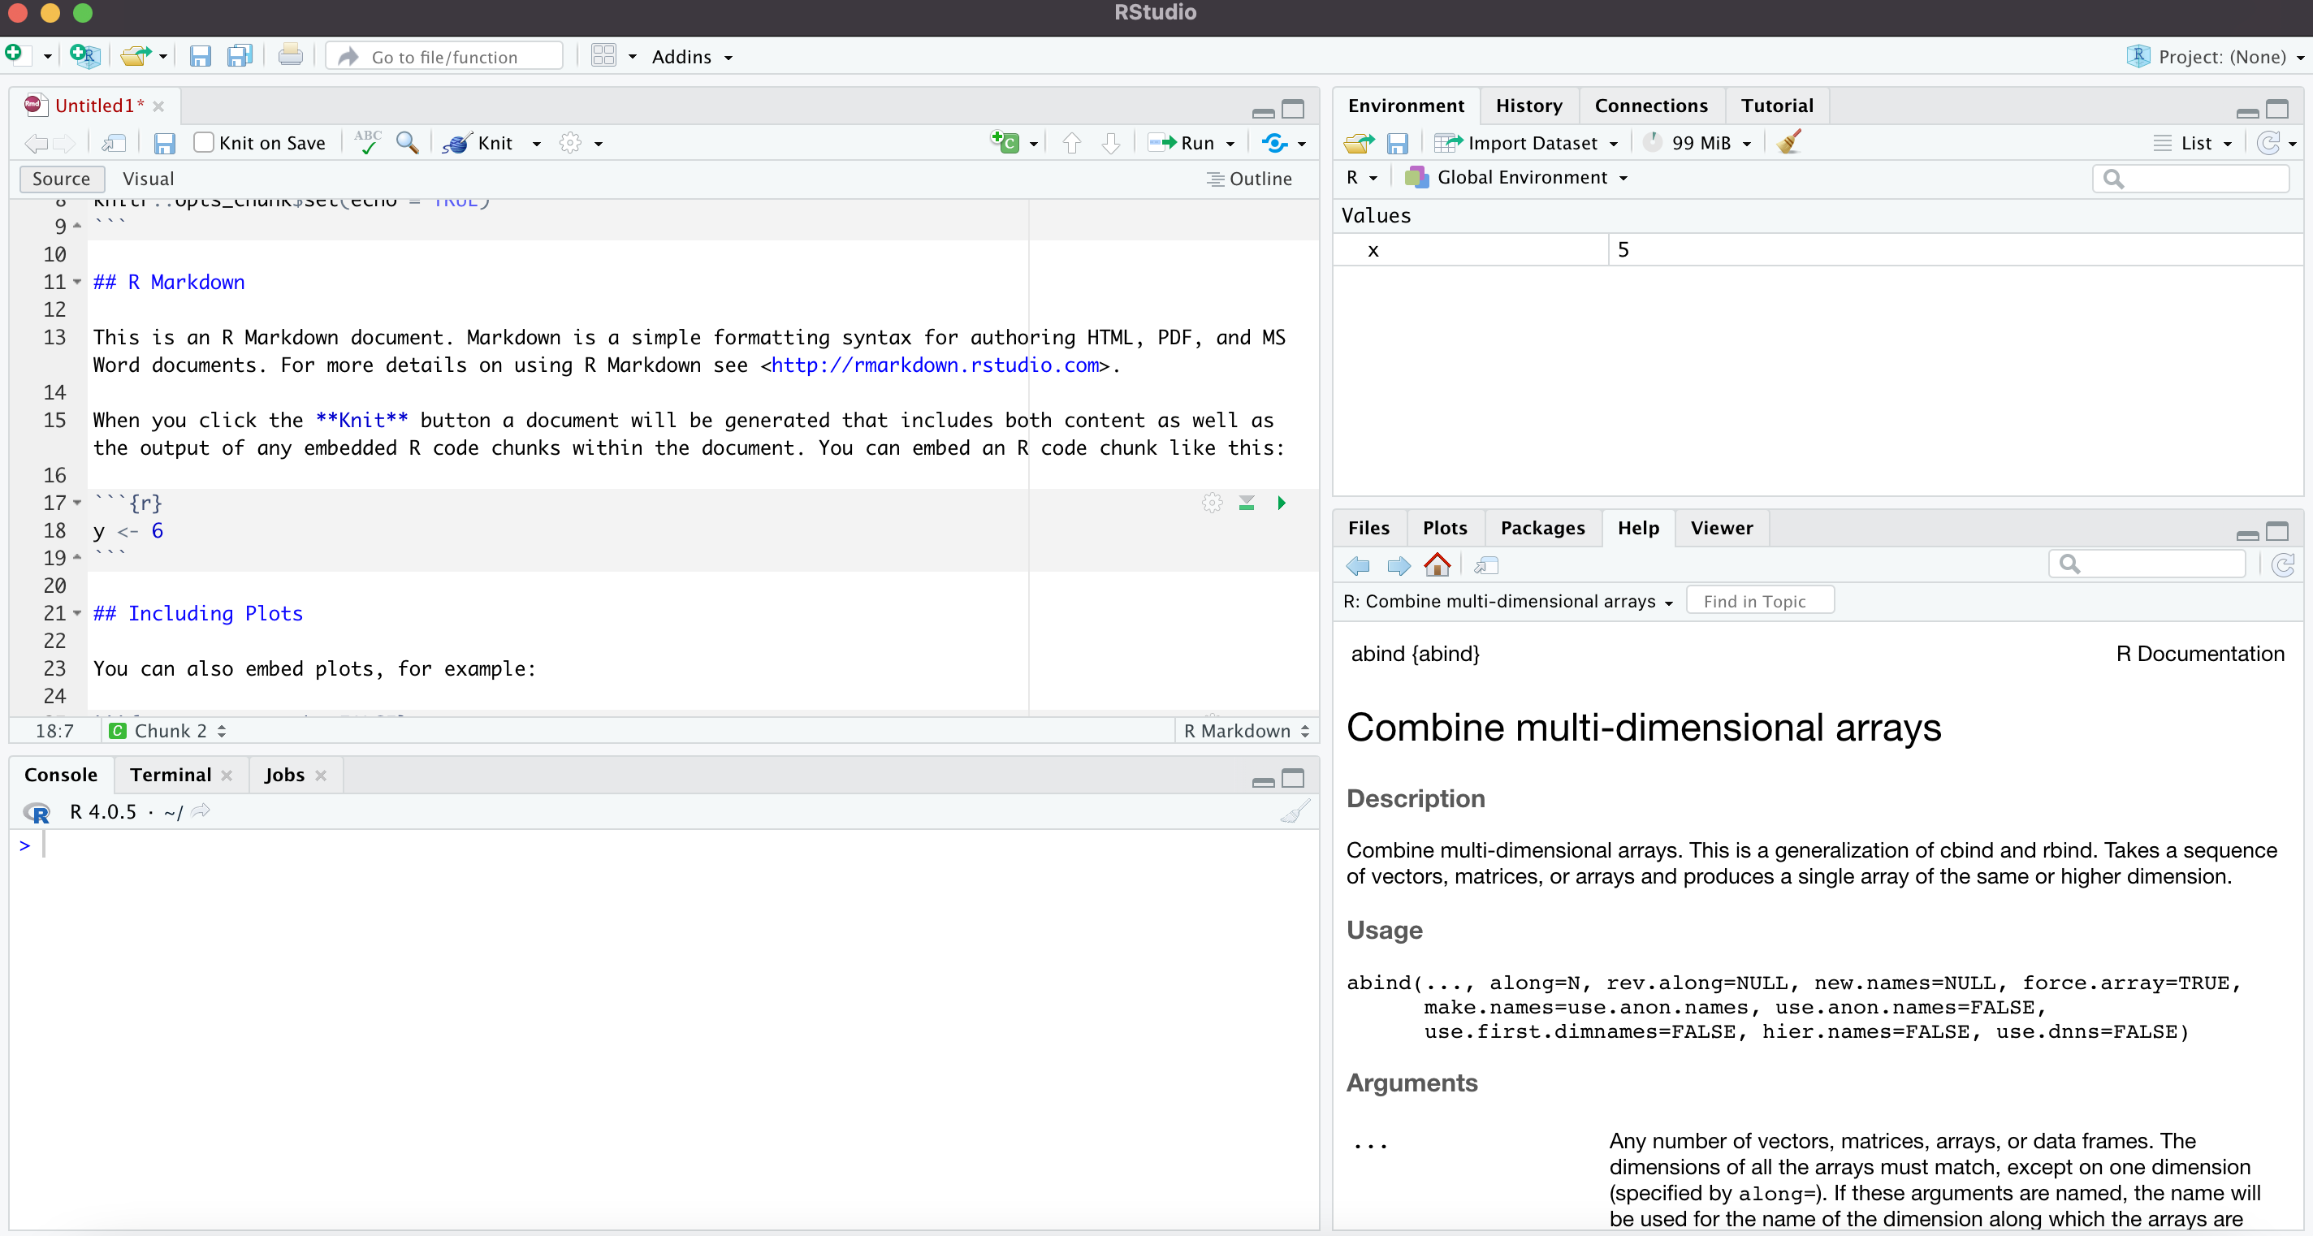
R Markdown
Run Code Chunk
Notes:
Console == where commands get typed

Slide 40
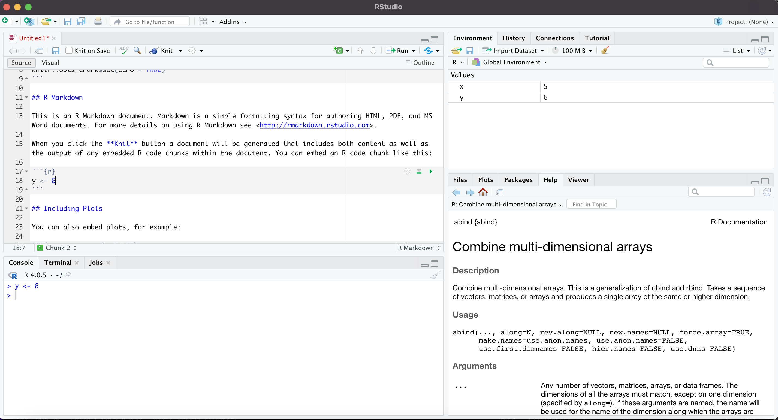
R Markdown
Notes:
Console == where commands get typed

Slide 41
R Markdown
Notes:
Console == where commands get typed

Slide 42
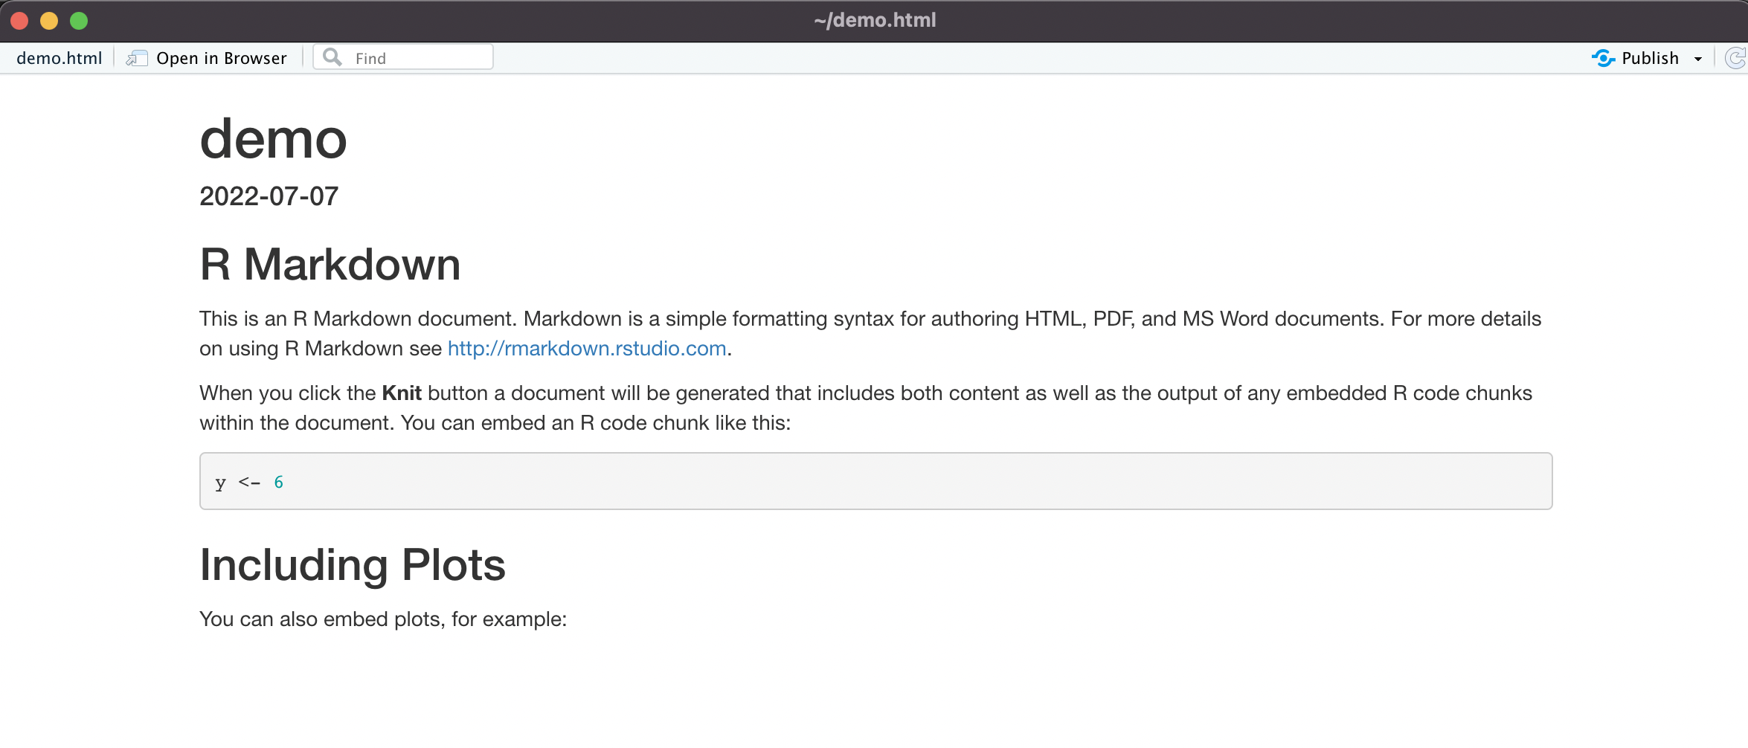
R Markdown
Notes:
Console == where commands get typed

Slide 43
R Markdown
Notes:
Console == where commands get typed

Slide 44
R Markdown
Notes:
Console == where commands get typed

Slide 45
R Markdown
For quick tips and reference, try:
https://www.rstudio.com/wp-content/uploads/2015/02/rmarkdown-cheatsheet.pdf
Notes:
Console == where commands get typed

